Slide 1
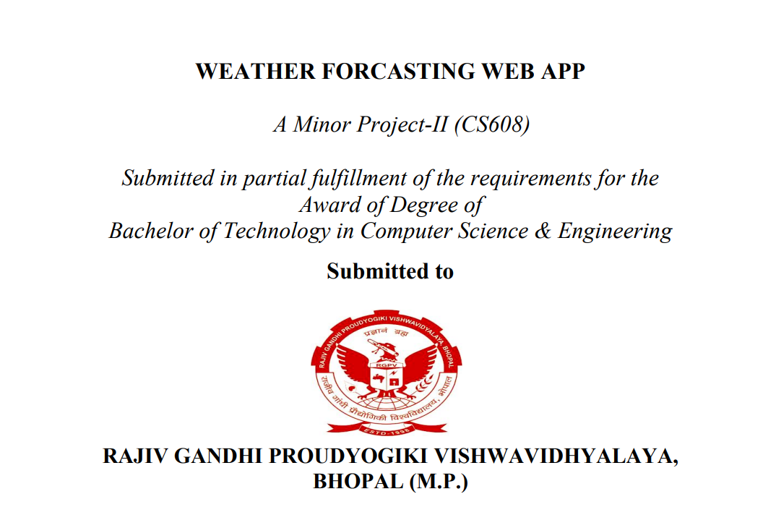

Slide 2
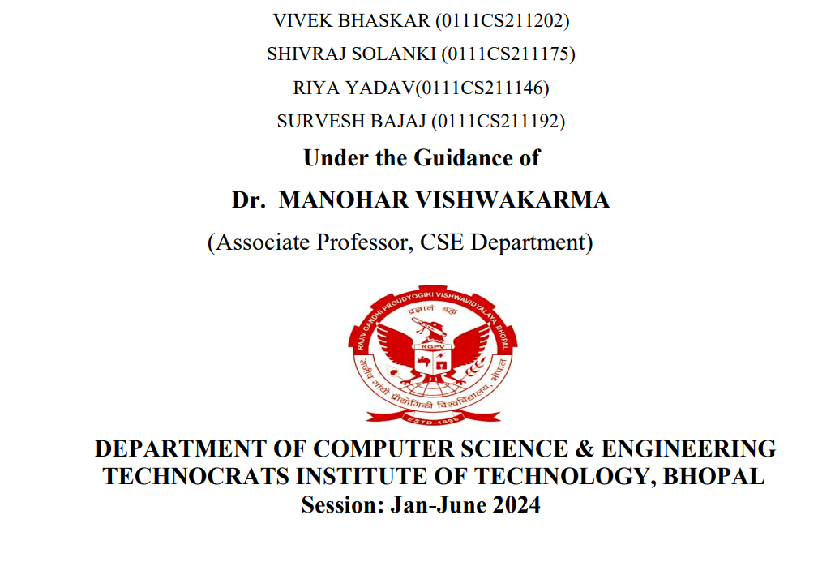
SUBMITTED BY
ISHA BISEN (0111AS211022)
BHAVYA DATTEY (0111AS211015)
PRADEEP PAWAR (0111AS211038)
HIMANSHU SAHU (0111AS211021)
PROF. SAGAR CHOUDHARY

Slide 3


Slide 4


Slide 5
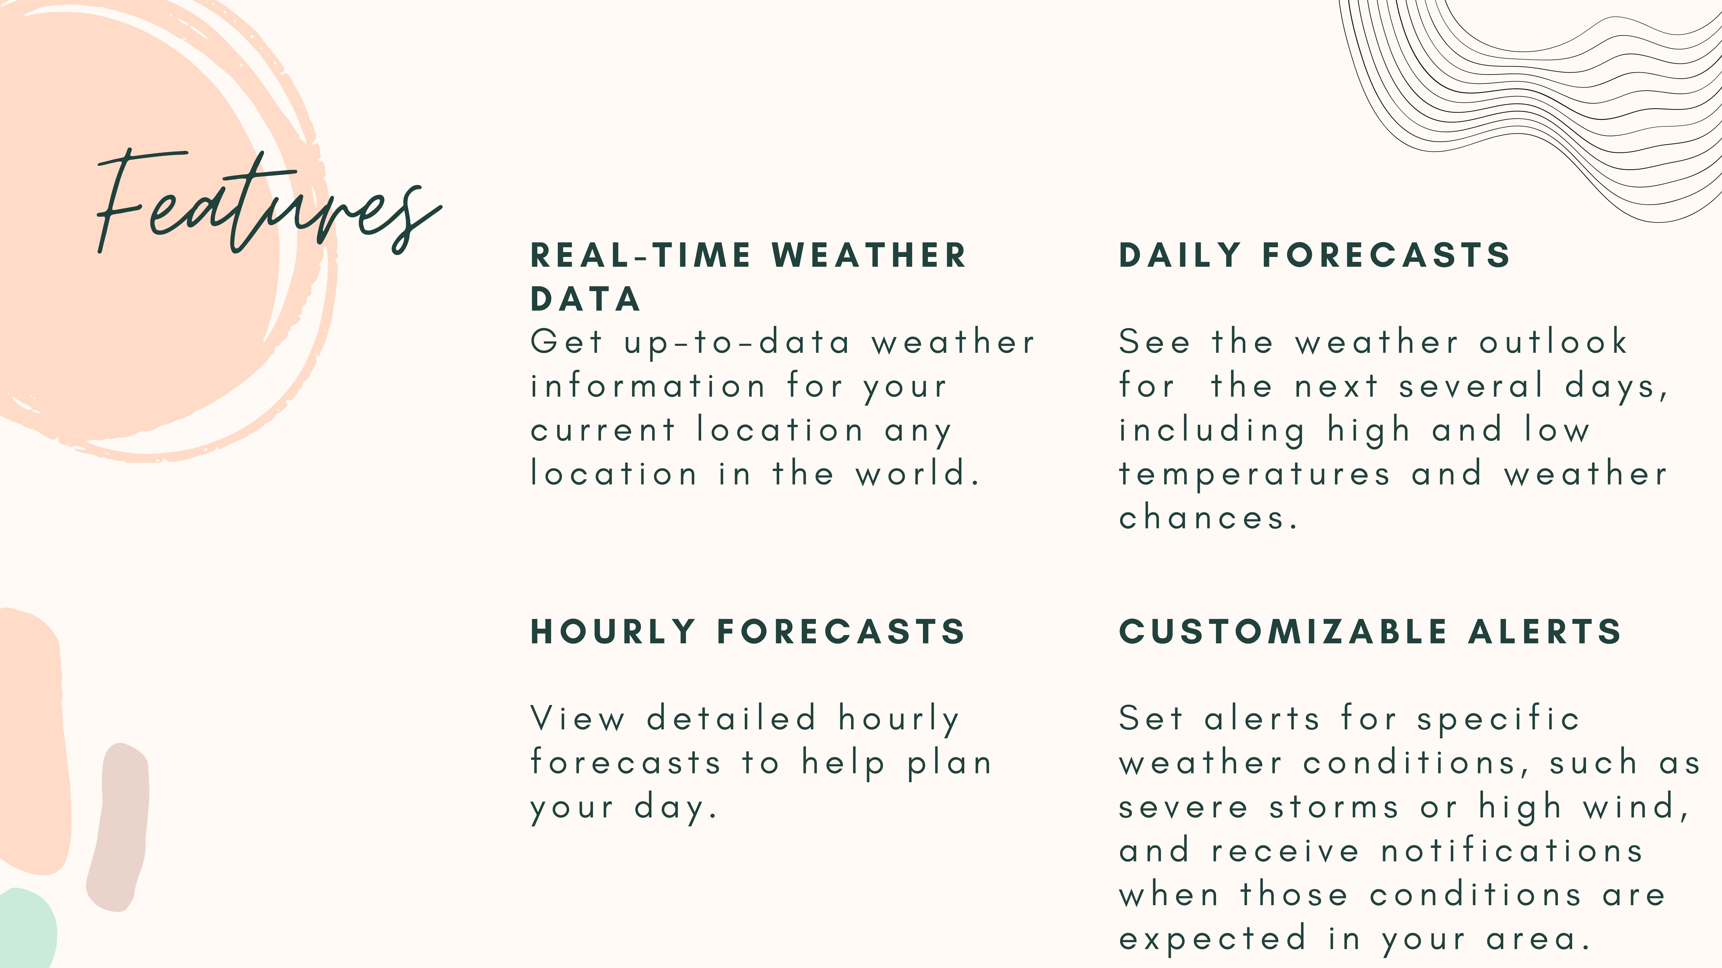

Slide 6


Slide 7


Slide 8
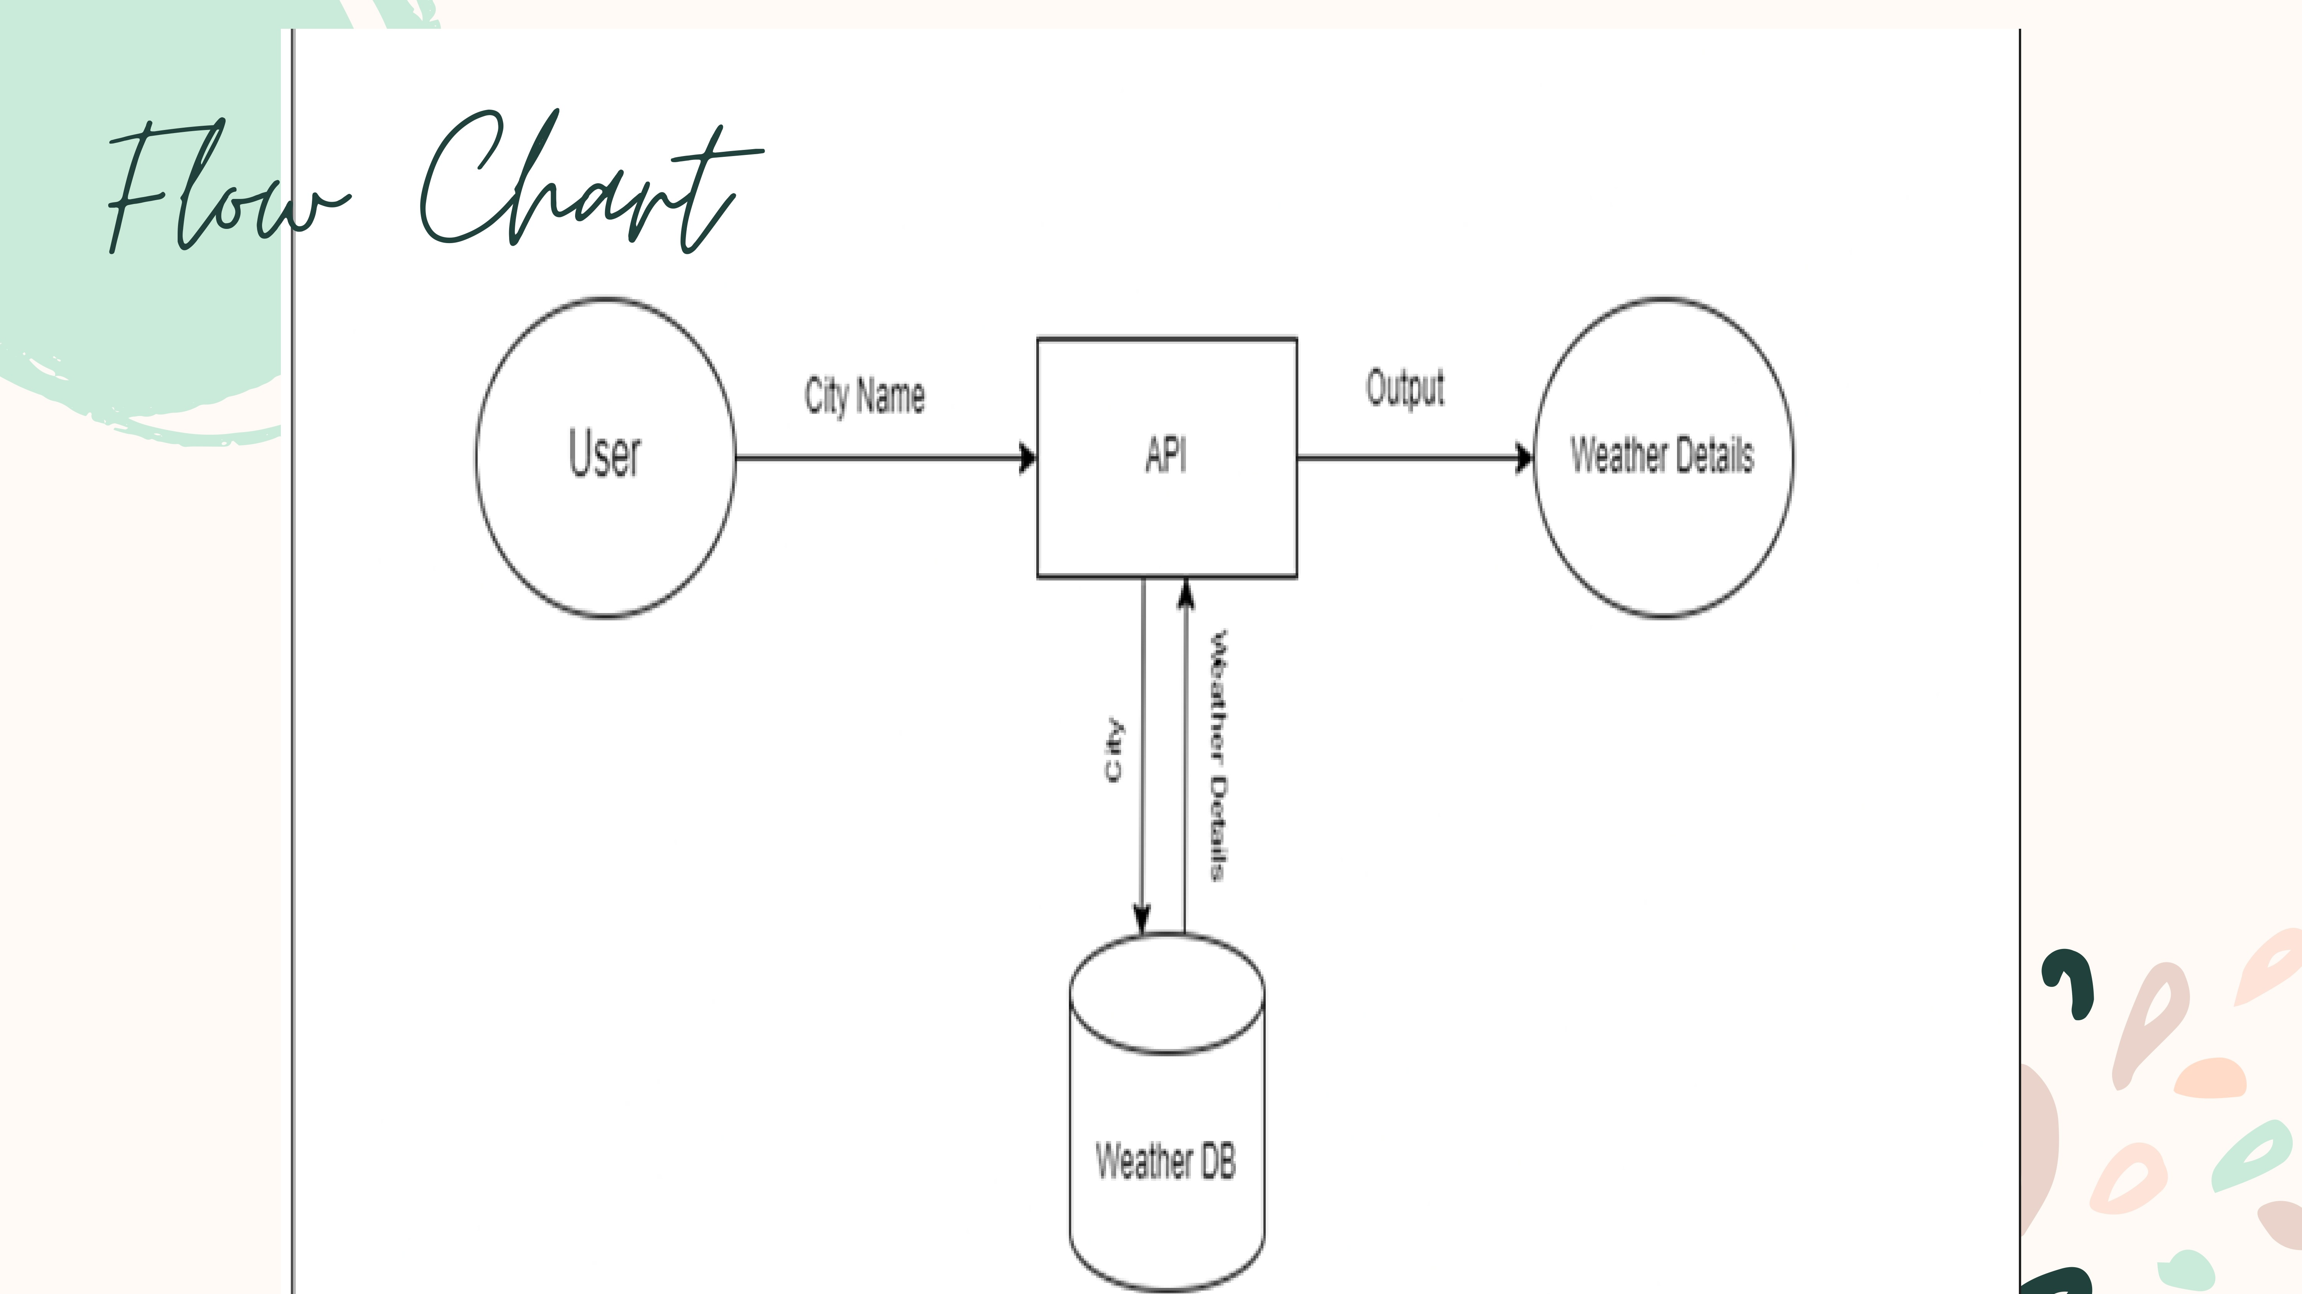

Slide 9
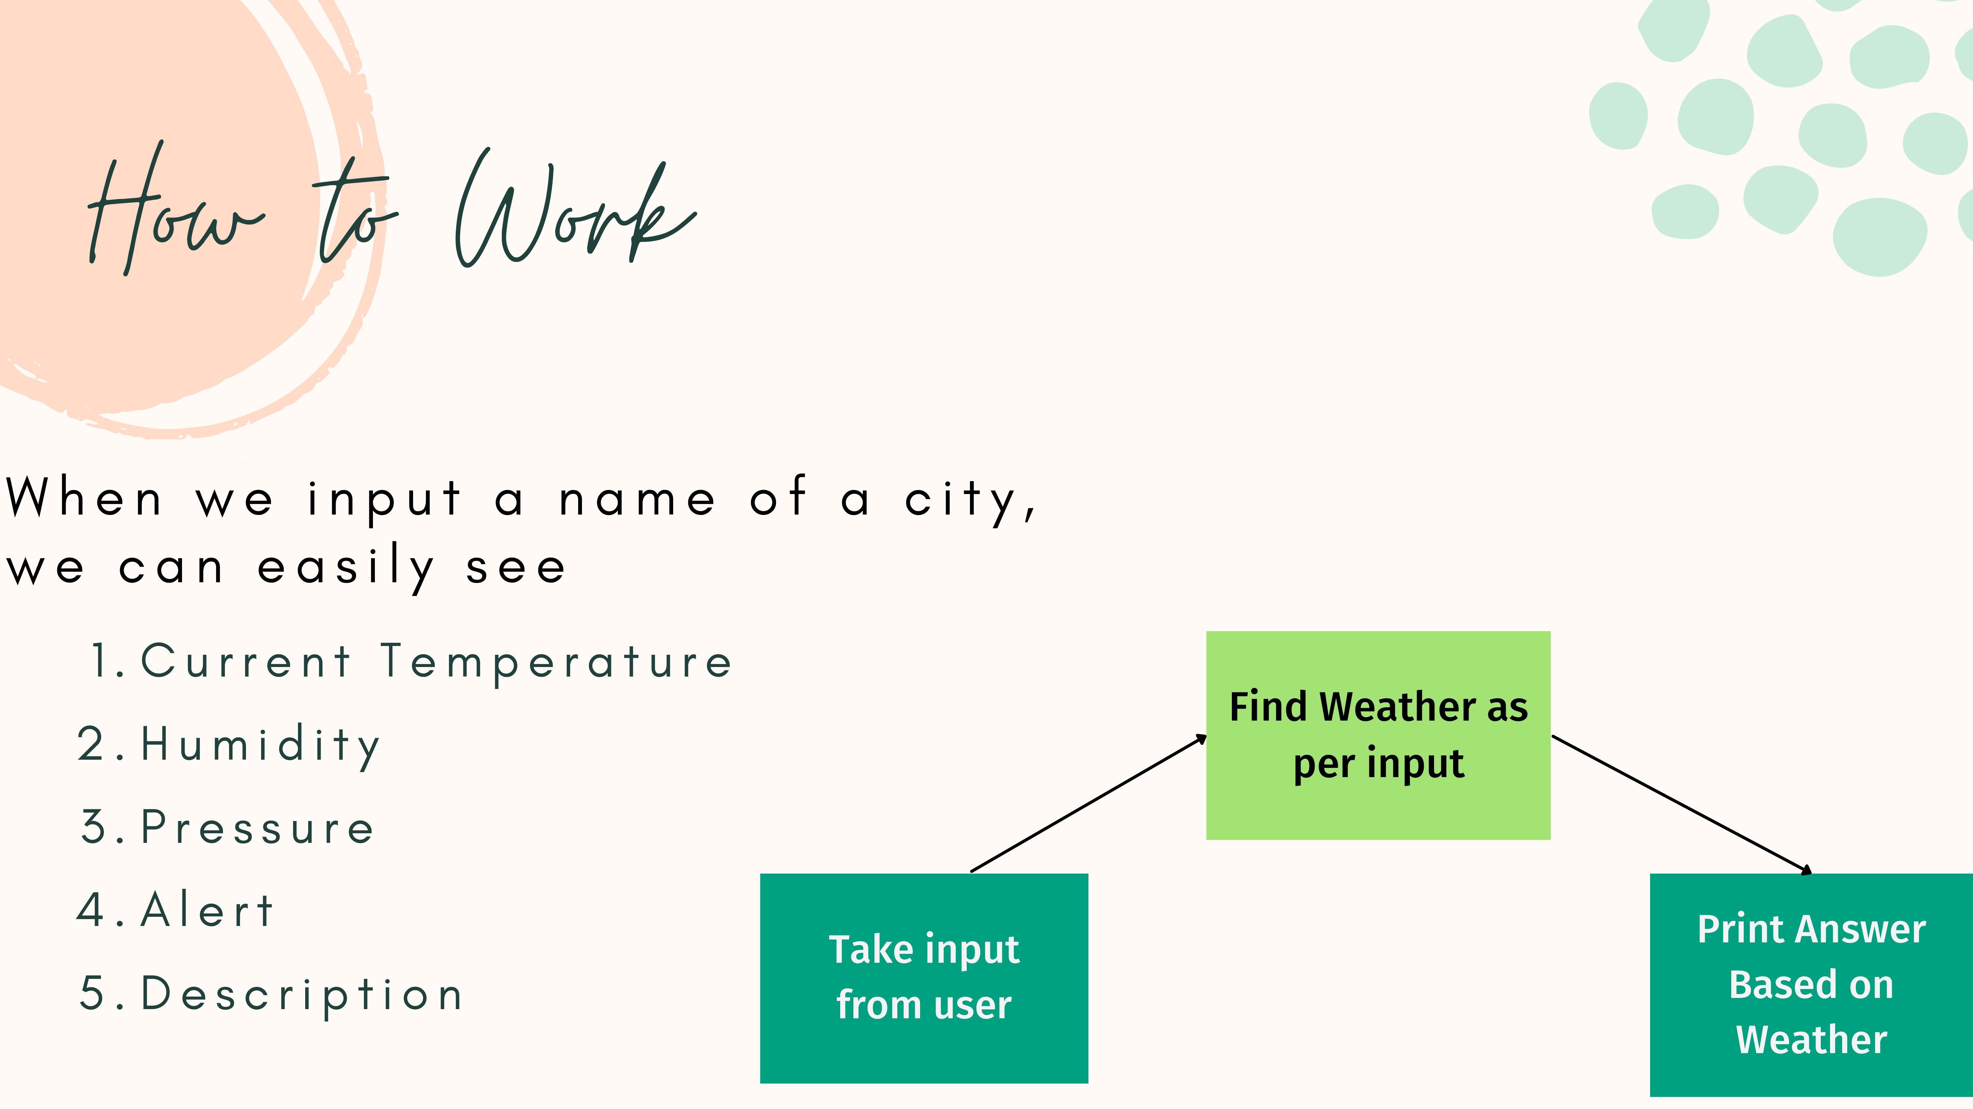

Slide 10


Slide 11


Slide 12


Slide 13


Slide 14
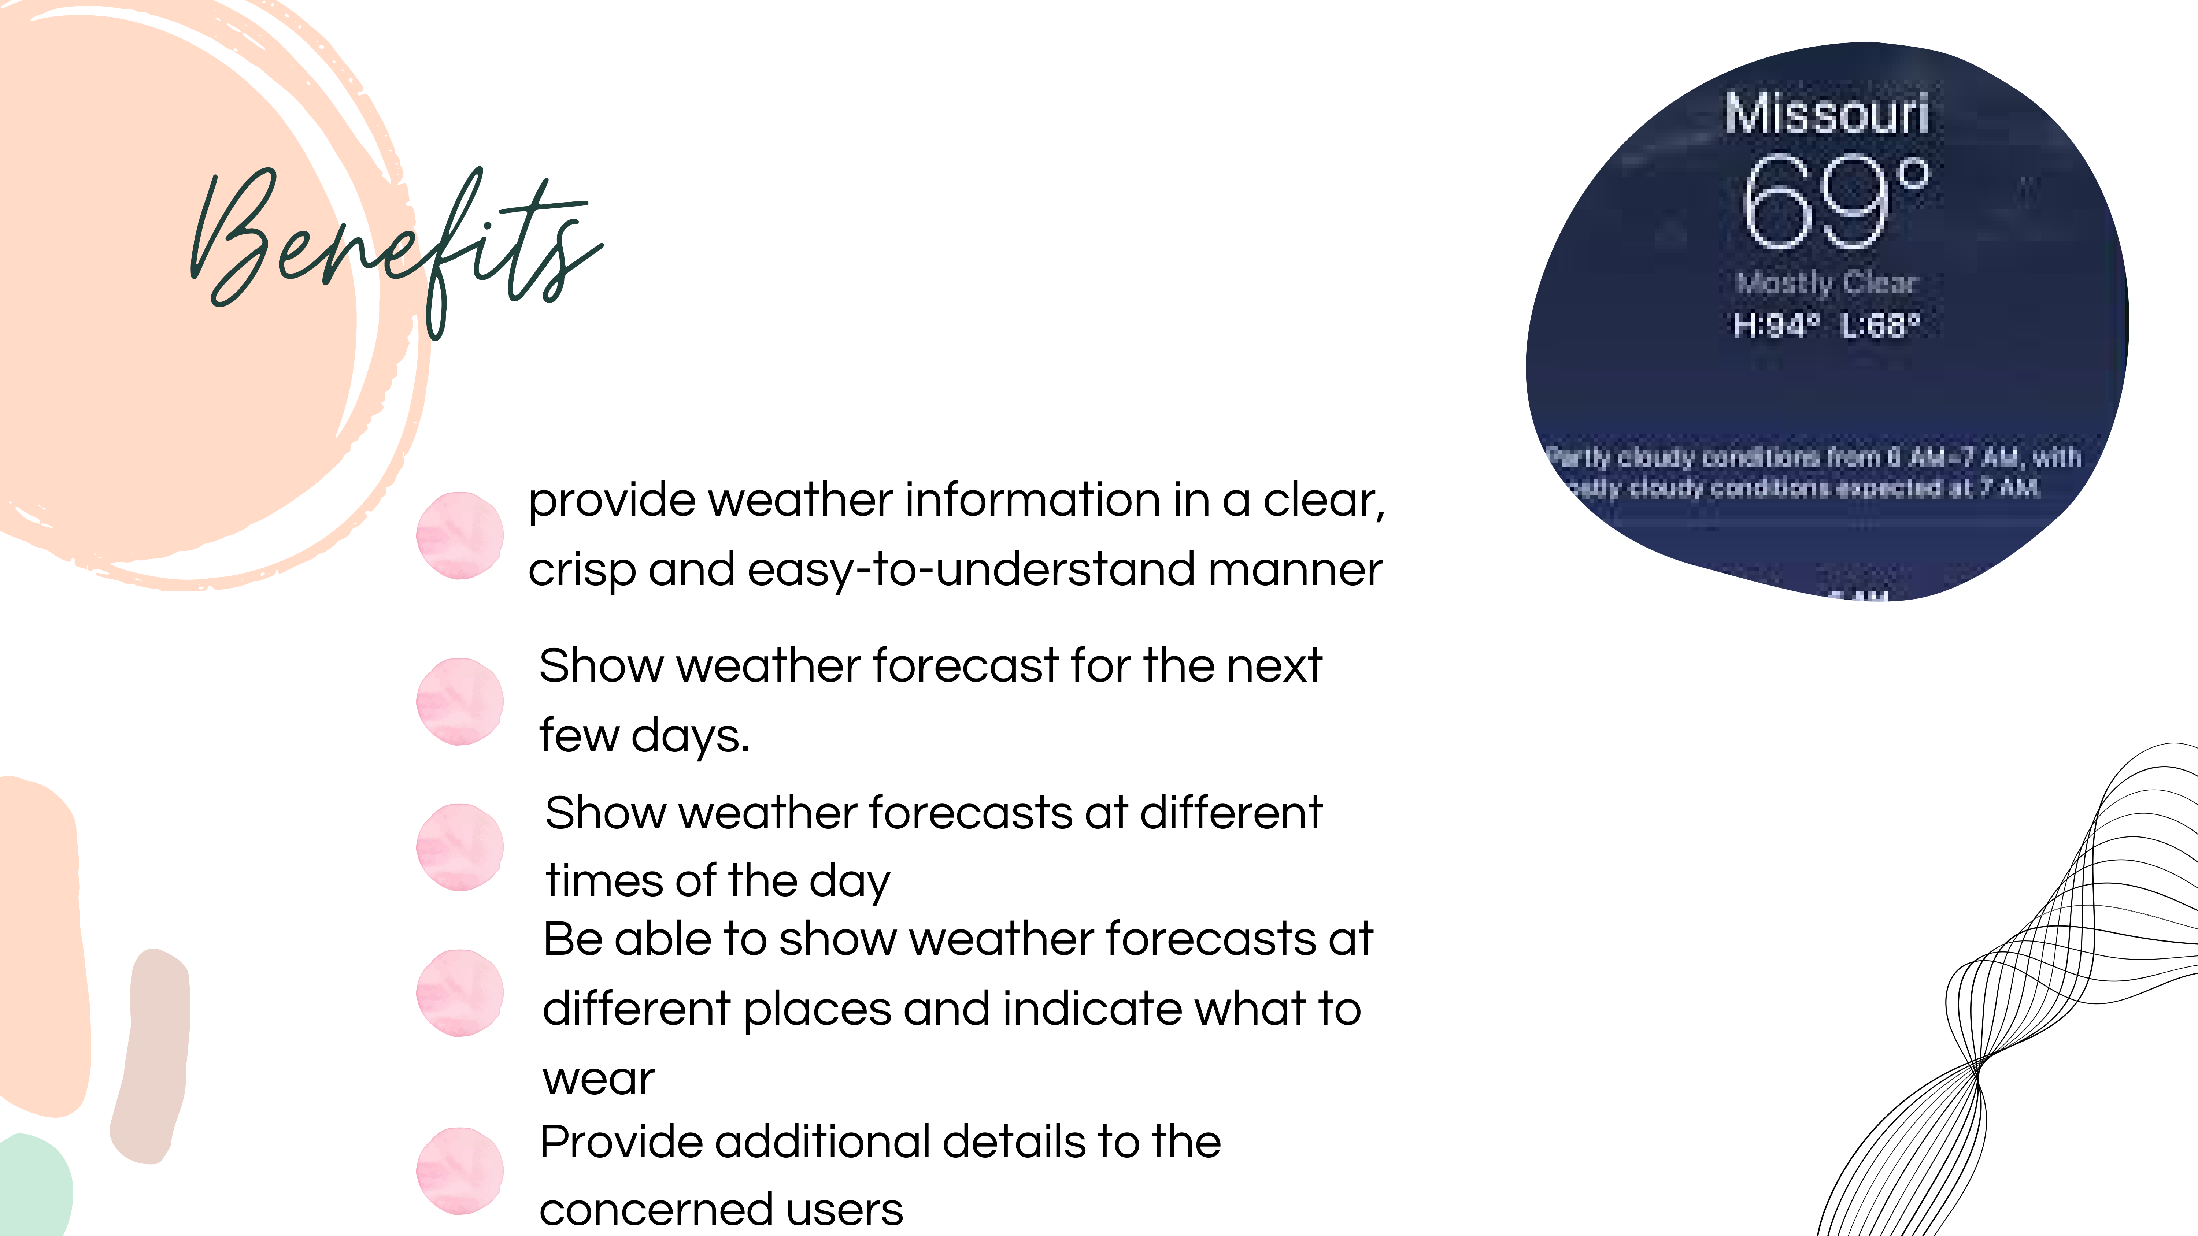

Slide 15


